Slide 1

MALIGNANT COMMENTS CLASSIFICATION

Slide 2

Business Problem
online hate and abuse comment

Slide 3

Hate speeches can be in the form of:
Racism
discrimination
Class
Nationality
Religion
Sexual orientation
Interests

Slide 4
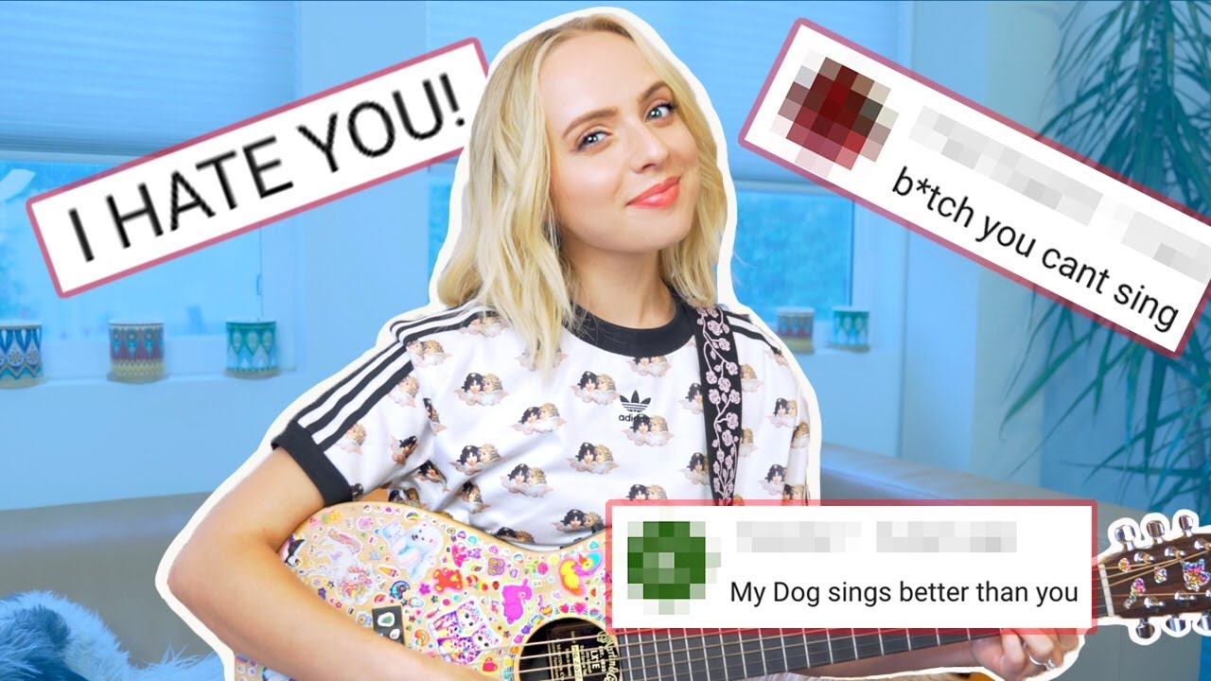
Online hate can discourage good innovation, talent or budding children
It can attack Children who are growing and are In the formative years

Slide 5

An attacker being anonymous
Can create hurt, depression
And lower self confidence of
People without even facing
Any consequences, which
Further motivates them towards
Such hate comment

Slide 6

In this age where people gain confidence through social media, these same social media can bully and harass them through hate comments

Slide 7
MODEL
Feature
Extend of offensiveness
Comment
malignant
highly_malignant
rude
threat
abuse
loathe

Slide 8
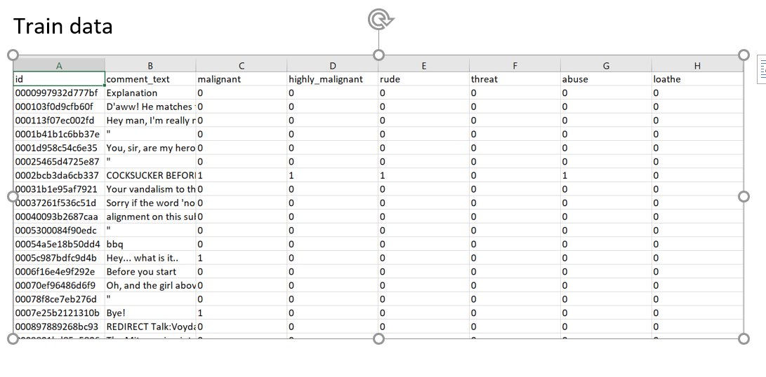
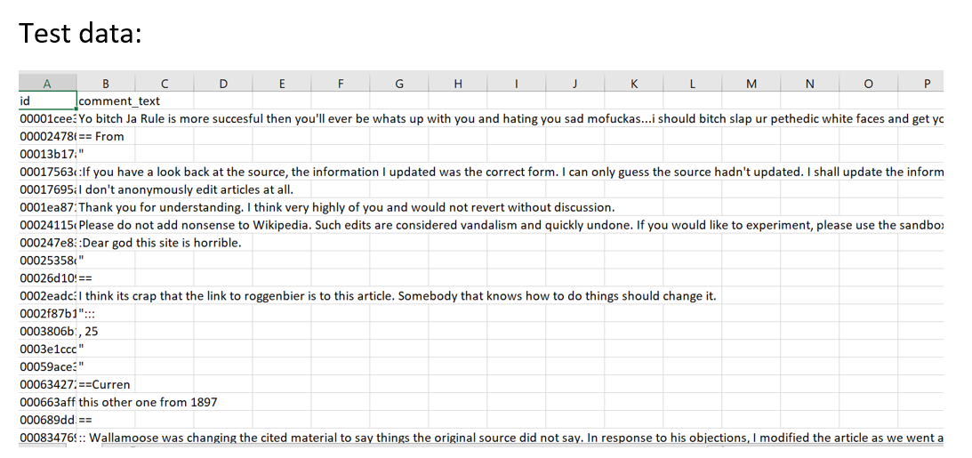
Data

Slide 9
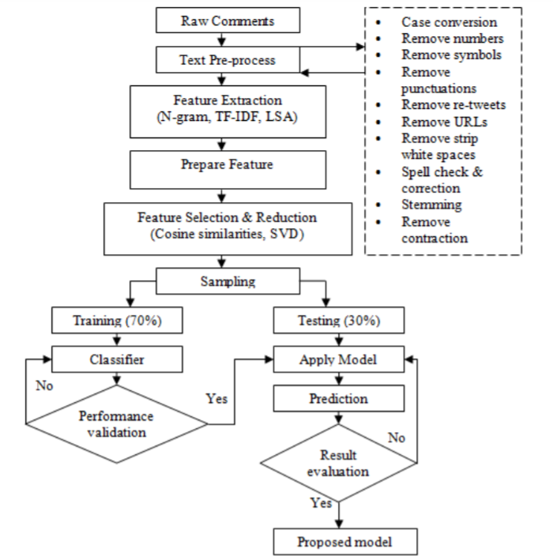
Model training and testing

Slide 10
Data Preprocessing
Checking null values
Calculating number of comments in each category
counting the number of comments having multiple labels
dropping id as its unique

Slide 11
WordCloud representation of most used words
Processing data removing
1.Tabs
2.Stop words
3.Punctuation
Making text into lower case

Slide 12
Training
Multilabel classifiers used
Binary Relevance
Adapted algorithm
Classifier Chain
LabelPowerset

Slide 13
Metrics obtained: accuracy scores
Multiple Binary Classifications One Vs Rest Classifier | malignant comments 0.9283333333333333 highly_malignant comments 0.9916666666666667 rude comments 9583333333333334 threat comments 0.9933333333333333 abuse comments 0.96 loathe comments 0.99
Binary Relevance | 89.83
Classifier Chains | 92.16
Label Powerset | 92.16
Adapted Algorithm | 91.66

Slide 14
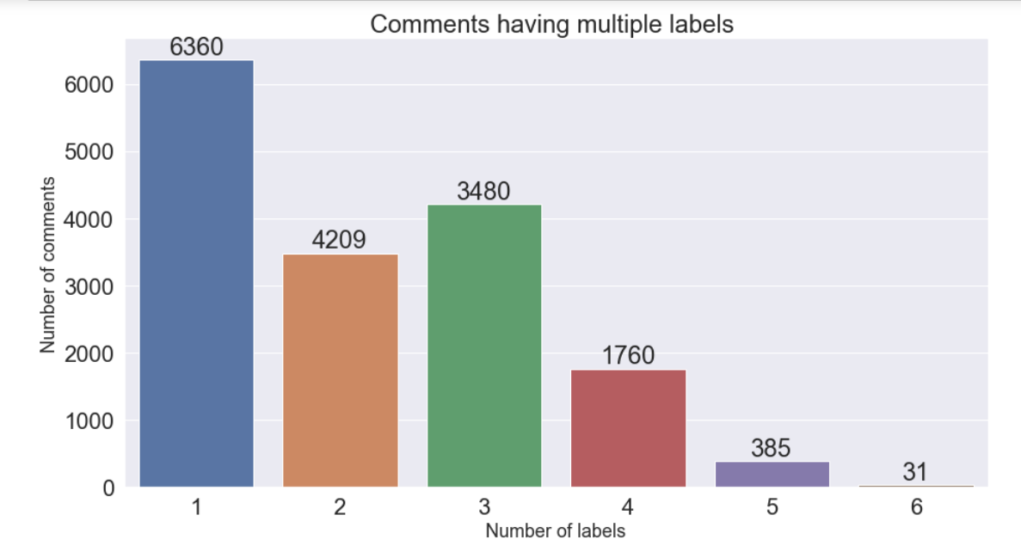
Maximum comments have one label

Slide 15
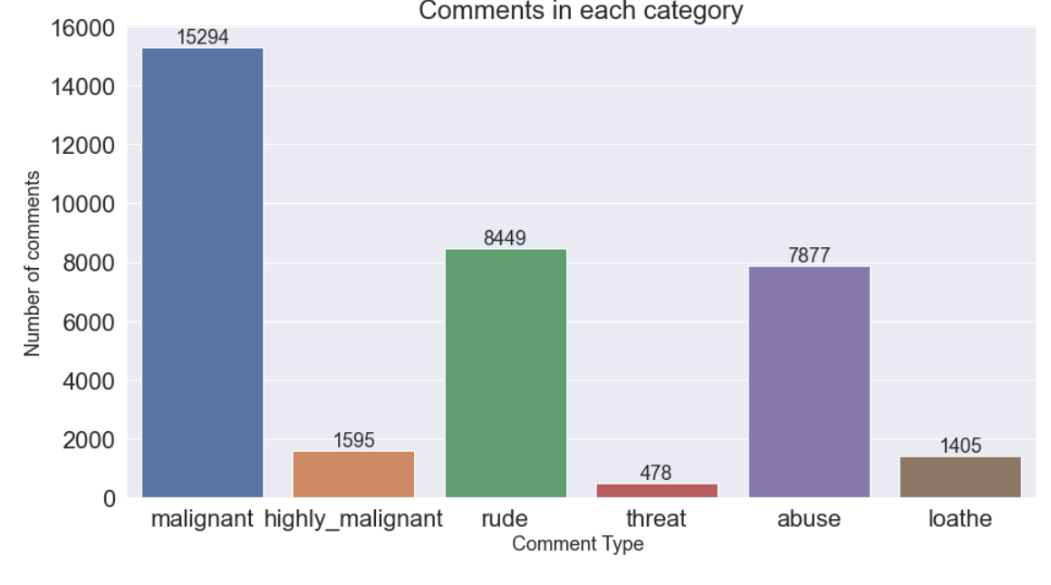
Highest comments are for malignant

Slide 16
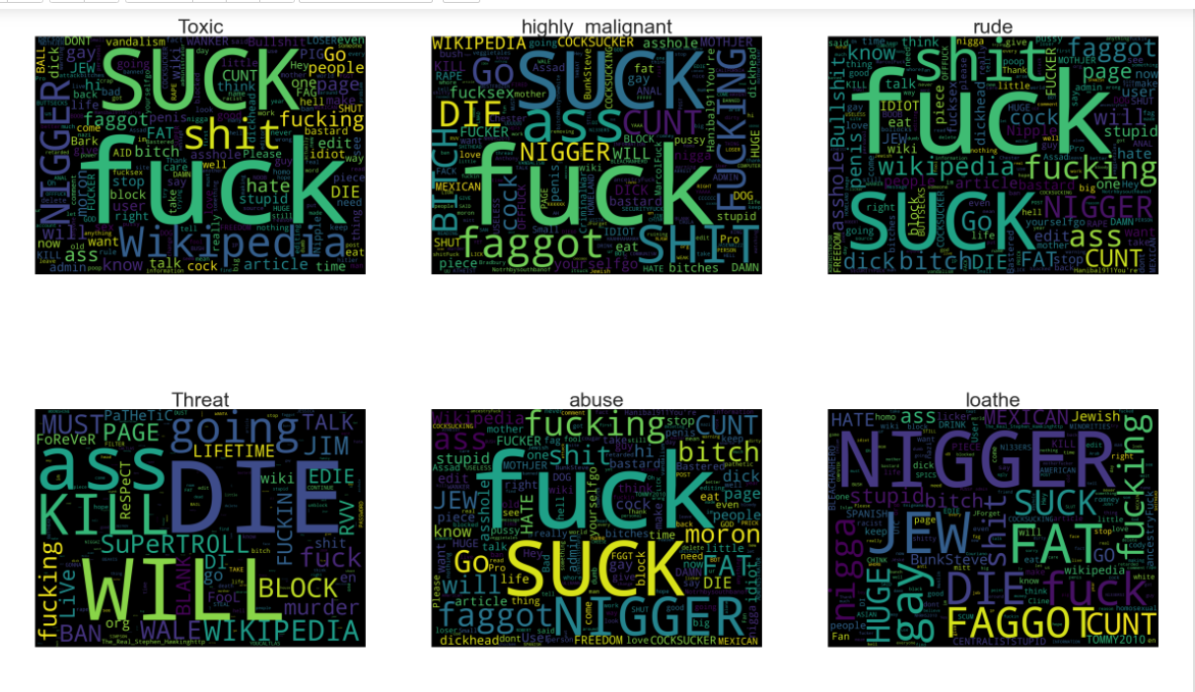
WordCloud representation of most used words

Slide 17
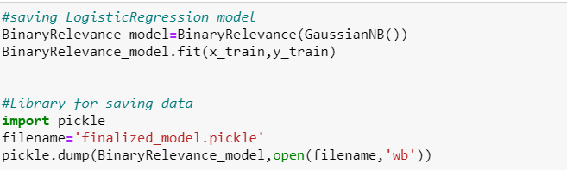
Finalized model

Slide 18
Thankyou Have a nice day

